Slide 1



IOT-ENABLED SMART WASTE COLLECTION SYSTEM WITH COMMUNITY SHARING AND REAL-TIME ROUTE OPTIMIZATION
RAKK RANASINGHE (D/BIT/22/0039)
Supervised By: Mr. RPS Kathriarachchi

Slide 2
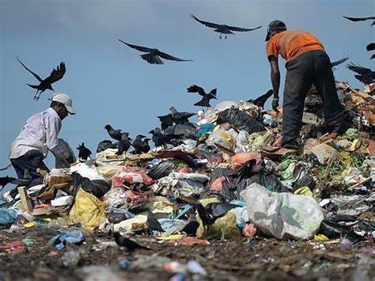
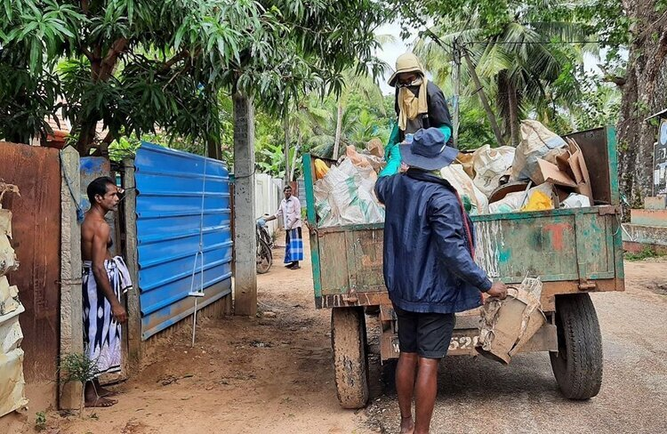
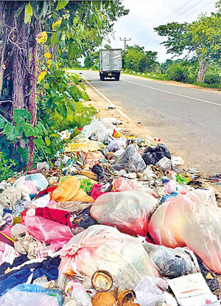
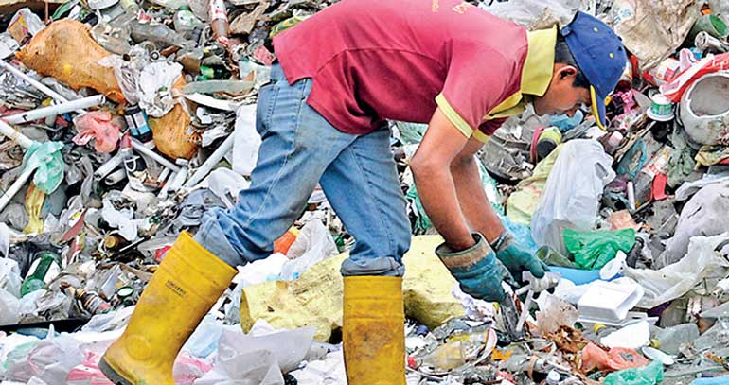
Familiar
with this ??

Slide 3
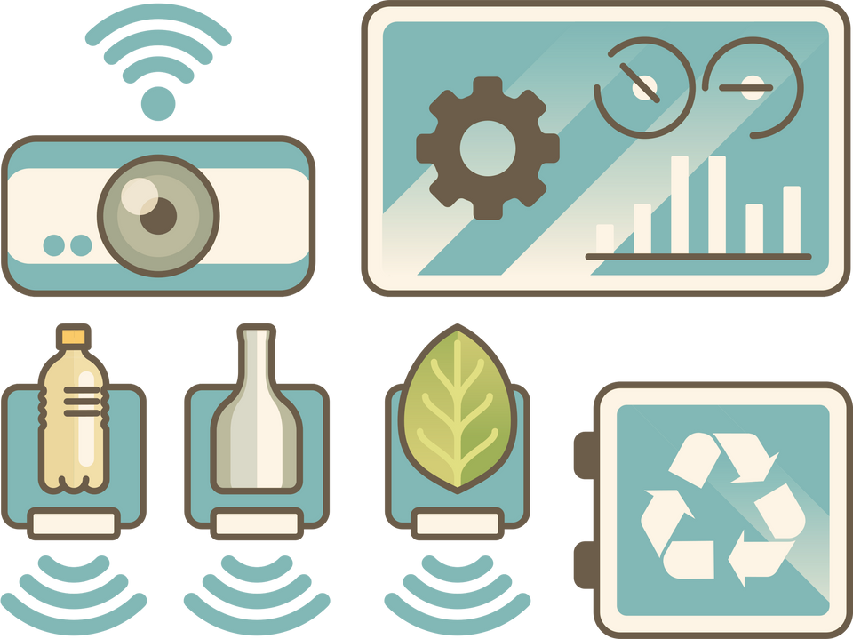

03
INTRODUCTION
Efficient waste collection is essential for cleanliness, sustainability, and community well-being. Challenges such as delays, missed locations, and inefficiencies can strain resources and increase costs. By incorporating real-time tracking, route optimization, and community sharing of reusable items, this system encourages timely pickups, reduces waste, and fosters collaboration among citizens to promote a cleaner, greener environment

Slide 4

04
PROBLEM DOMAIN
Current waste collection systems face significant challenges that hinder efficiency and sustainability
Inefficient Collection: Delays, missed pickups, and unoptimized routes increase costs
No Real-Time Tracking: Limits monitoring of bins and vehicles
Reusable Waste Loss: Lack of community sharing discards reusable items
Environmental Risks: Accumulated waste causes pollution and health hazards
Low Public Involvement: Lack of tools for citizen participation

Slide 5
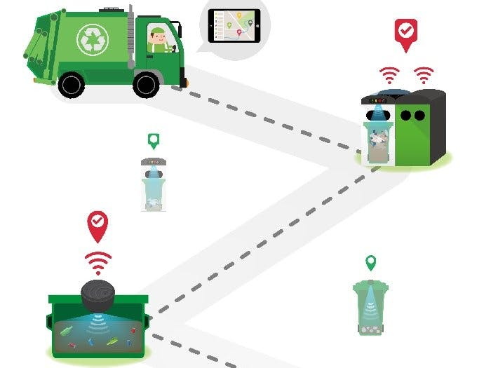
05
PROPOSED SOLUTION
To tackle the challenges in waste collection, a comprehensive solution is proposed, integrating advanced technologies and community-driven initiatives to enhance efficiency, sustainability, and public engagement
IoT-enabled bins for real-time monitoring
AI-based route optimization
Mobile/web apps for tracking and reporting
Community sharing to reduce waste
Real-time truck tracking and data analytics

Slide 6

06
METHODOLOGY
Requirement Gathering: Analyze waste collection processes, challenges, and user needs with stakeholders
System Design: Use microservices for modular functionalities like tracking, notifications, and reporting
Development: Follow Agile methodology for incremental feature implementation and frequent testing
Testing: Perform user acceptance testing to ensure usability and effectiveness
Deployment and Feedback: Launch the system, collect feedback, and improve features iteratively

Slide 7

07
FUNCTIONAL REQUIREMENTS
Waste Collection Monitoring: IoT bins send real-time data; residents schedule pickups
Community Sharing: Share reusable items via the app
Immediate Pickups: Residents request urgent pickups; drivers get real-time alerts
Route Optimization & Tracking: Generates and updates efficient routes; displays bin locations and optimized paths
Alerts & Notifications: Real-time updates for users and drivers
Reports & Analytics: Insights on waste trends and system performance
User Management: Manage accounts, roles, and user activity

Slide 8
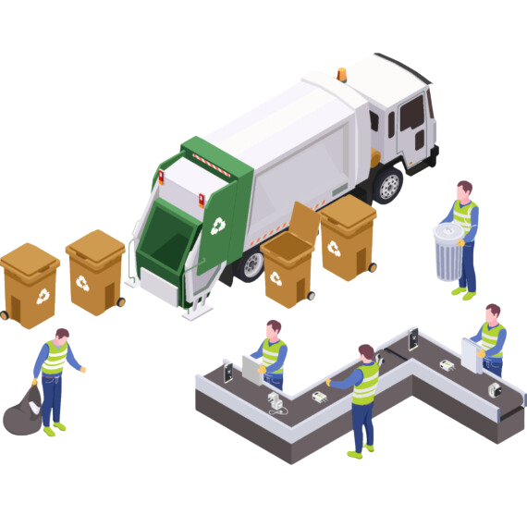
08
NON -FUNCTIONAL REQUIREMENTS
Scalability: Support growth in users, IoT devices, and trucks
Reliability: Ensure continuous uptime and system stability
Performance: Deliver real-time updates and notifications efficiently
Security: Protect data with encryption and controlled access
User-Friendly: Provide intuitive and accessible interfaces for all users
Profit Projections

Slide 9
09
AIMS & OBJECTIVES
Objectives:
Track waste bins and trucks in real-time
Optimize collection routes using AI
Provide mobile and web apps for user notifications
Enable on-demand waste pickup
Allow users to share reusable waste items
Guide users on proper waste segregation
Let citizens report waste-related issues
Aim:
To develop a Smart Waste Collection System that improves efficiency, reduces costs, and enhances user engagement

Slide 10












10
TECHNOLOGIES
Prototyping: Figma
Hardware (IoT Bin): ESP32, GPS (NEO-6M), LoRa/BLE, LEDs
Front-end Development: React, Flutter
Back-end Development: Node.js, Express.js, Google Maps API
Databases: Firebase
Communication: ESP-NOW, MQTT, HTTP/HTTPS
Version Control: Git, GitHub

Slide 11
11
LITERATURE REVIEW - SUMMARY
Focus | Key Findings | Autor and Year
IoT | IoT-enabled real-time monitoring reduced overflow risks, improved efficiency, and saved resources | Zeb et al. (2024) [1], Haque et al. (2024) [2], Folianto et al. (2019) [4]
Route Optimization | Optimized collection routes, minimized carbon emissions, and reduced fuel consumption | Lozano et al. (2016) [5], Mukherjee et al. (2021) [10]
Cost Efficiency | Enhanced cost efficiency, reduced operational costs, and saved energy | Mukherjee et al. (2021) [6], Lozano et al. (2016) [5]
AI & Machine Learning | Improved prediction accuracy and reduced waste transport inefficiencies through AI algorithms | Rutqvist et al. (2019) [7]
Community Engagement | Encouraged community participation, improved recycling rates, and supported 3R principles | Abd Wahab et al. (2021) [12]

Slide 12
12
Focus | Key Findings | Autor and Year
Cost Reduction & Sustainability | Reduced cleanup costs by 58 million USD and aligned with SDGs | Mager et al. (2022) [13]
Waste Bin Monitoring | Improved waste bin filling forecasts, reduced overflow situations, and enabled efficient resource use | Morais et al. (2024) [11]
Recycling & User Interface | Addressed recycling inefficiencies and hazardous material handling through tailored user interfaces | Donny et al. (2022) [9]
Sustainability | Enhanced traceability and promoted sustainability through smart waste management solutions | Fatimah et al. (2020) [8]
Energy Conversion | Highlighted energy conversion methods and cost-effective waste management strategies | Mukherjee et al. (2021) [6]

Slide 13
13
References
[1] “What a Waste 2.0 : A Global Snapshot of Solid Waste Management to 2050,” World Bank. Accessed: Oct. 29, 2024.Available:https://documents.worldbank.org/pt/publication/documents.
[2] “Modern Technologies for Waste Management: A Review.” Accessed: Oct. 25, 2024. [Online]. Available: https://www.mdpi.com/2076-3417/13/15/8847
[3] B. Chowdhury and M. U. Chowdhury, “RFID-based real-time smart waste management system,” in 2007 Australasian Telecommunication Networks and Applications Conference, Dec. 2007, pp. 175–180. doi: 10.1109/ATNAC.2007.4665232.
[4] Z. Hisham Che Soh, M. Azeer Al-Hami Husa, S. Afzal Che Abdullah, and M. Affandi Shafie, “Smart Waste Collection Monitoring and Alert System via IoT,” Apr. 2019, pp. 50–54. doi: 10.1109/ISCAIE.2019.8743746.
[5] M. Aazam, M. St-Hilaire, C.-H. Lung, and I. Lambadaris, “Cloud-based smart waste management for smart cities,” in 2016 IEEE 21st International Workshop on Computer Aided Modelling and Design of Communication Links and Networks (CAMAD), Oct. 2016, pp. 188–193. doi: 10.1109/CAMAD.2016.7790356.
[6] A. Goutam Mukherjee et al., “A review on modern and smart technologies for efficient waste disposal and management,” J. Environ. Manage., vol. 297, p. 113347, Nov. 2021, doi: 10.1016/j.jenvman.2021.113347.
[7] R. K. A. R. Kariapper, P. Pirapuraj, M. S. S. Razeeth, A. C. M. Nafrees, and K. L. M. Rameez, “Smart Garbage Collection Using GPS & Shortest Path Algorithm,” in 2019 IEEE Pune Section International Conference (PuneCon), Dec. 2019, pp. 1–6. doi: 10.1109/PuneCon46936.2019.9105674.
[8] Y. A. Fatimah, A. Widianto, and M. Hanafi, “Cyber-physical System Enabled in Sustainable Waste Management 4.0: A Smart Waste Collection System for Indonesian Semi-Urban Cities,” Procedia Manuf., vol. 43, pp. 535–542, 2020, doi: 10.1016/j.promfg.2020.02.169.

Slide 14
14
References Cont.
[9] C. S. de Morais, T. R. P. Ramos, M. Lopes, and A. P. Barbosa-Póvoa, “A data-driven optimization approach to plan smart waste collection operations,” Int. Trans. Oper. Res., vol. 31, no. 4, pp. 2178–2208, 2024, doi: 10.1111/itor.13235.
[10] S. Keerthana, B. Kiruthika, R. Lokeshvaran, B. Midhunchakkaravarthi, and G. Dhivyasri, “A Review on Smart Waste Collection and Disposal System,” J. Phys. Conf. Ser., vol. 1969, p. 012029, Jul. 2021, doi: 10.1088/1742-6596/1969/1/012029.
[11] “Development of User Interface Design for Electronic Waste Collection with a Design Thinking Approach,” in Proceedings of the International Conference on Industrial Engineering and Operations Management, Orlando, USA: IEOM Society International, Jun. 2022, pp. 1636–1646. doi: 10.46254/NA07.20220383.
[12] K. Leelarathne, R. T. Niroshan, and L. P. Kalansooriya, “Optimum Waste Collection System with Smart Mobile Application,” 2021, Accessed: Aug. 06, 2024. [Online]. Available: https://scholar.google.com/scholar?cluster=9887963207950108195&hl=en&oi=scholarr
[13] A. Fernando and R. Kathriarachchi, “IoT Based Smart Solution for Waste Collection and Recycle,” Sep. 2019.
[14] E. Fidje, M. Haddara, and M. Langseth, “Sustainable Smart Waste Management Adoption Challenges in Developing Countries,” Procedia Comput. Sci., vol. 219, pp. 905–914, Jan. 2023, doi: 10.1016/j.procs.2023.01.366.
[15] A. Mager and V. Blass, “From Illegal Waste Dumps to Beneficial Resources Using Drone Technology and Advanced Data Analysis Tools: A Feasibility Study,” Remote Sens., vol. 14, no. 16, Art. no. 16, Jan. 2022, doi: 10.3390/rs14163923.
[16] T. Sutikno, H. I. K. Fathurrahman, T. Wahono, and L. Handayani, “Robotics Technologies in Urban Smart Waste Management,” High-Tech Innov. Ser., vol. 1, pp. 43–54, Jun. 2024.
[17] “IoT based Waste Bin Monitoring for Smart Cities.” Accessed: Oct. 27, 2024. [Online]. Available: https://psiborg.in/iot-based-waste-bin-monitoring-for-smart-cities/
[18] P. D. Gunasekara, “SMART SYSTEM FOR WASTE MANAGEMENT”.

Slide 15
THANK YOU !

